Slide 1




The Simple Alternative to
TeamViewer
DISCOVER
2025

Slide 2



EFFICIENT
PROVIDE secure remote support faster than ever.
2
13
EFFORTLESS
Don’t spend time and money using TeamViewer.
just click, connect, and save on your budget!
ECONOMIC

Slide 3

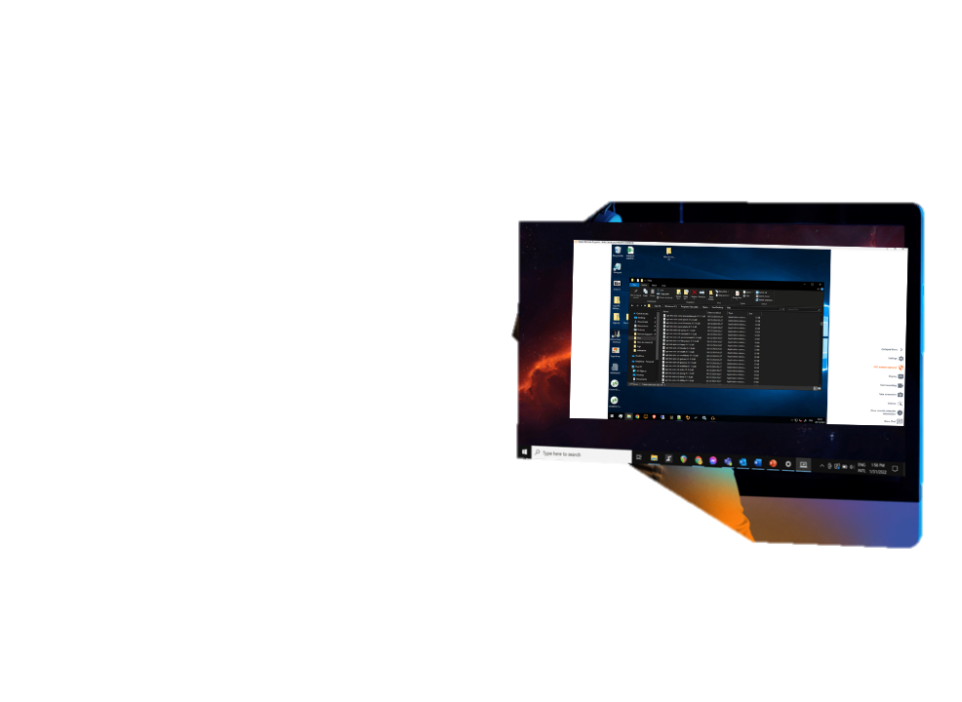


Instantly Access your Users’ devices and Troubleshoot Problems in No Time
3
Deliver support services 24/7
with a powerful solution
13
Remote Desktop Control
Screen & Keyboard Sharing
Unattended access
Execute Commands Remotely
Windows, Mac OS and Android

Slide 4
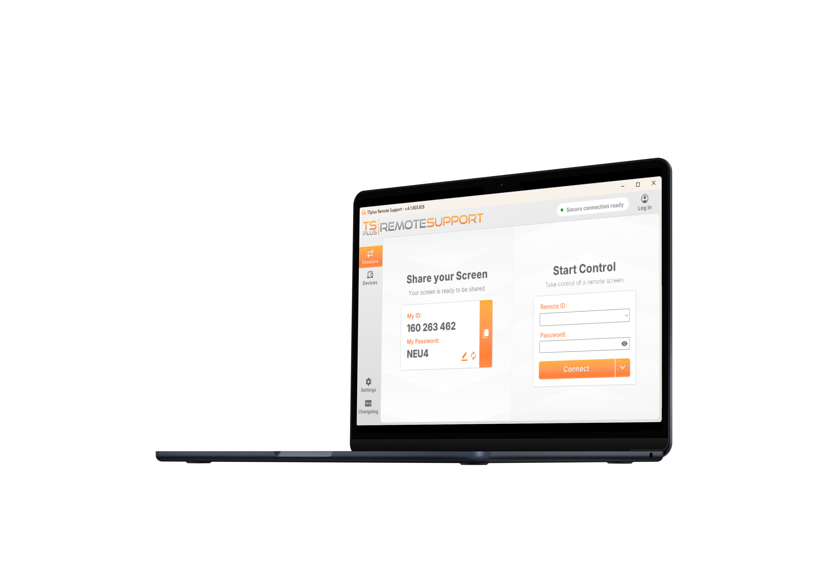
Give Your Support
Agents the Best Tools
for the Best Service
Quick installation
4
Single small program to share and control
Zero installation on the client side
Lite connection client (Client Generator)
13

Slide 5
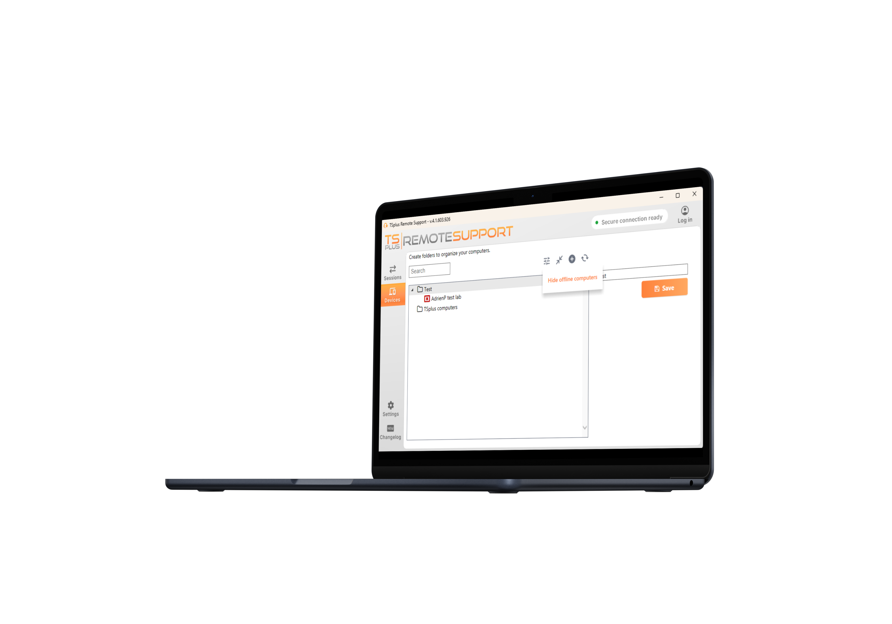
Give Your Support
Agents the Best Tools
for the Best Service
SMART administration
5
Centralized computers management
Structured organization by folders
Access to client system Information
Agents accounts can store configuration
13

Slide 6
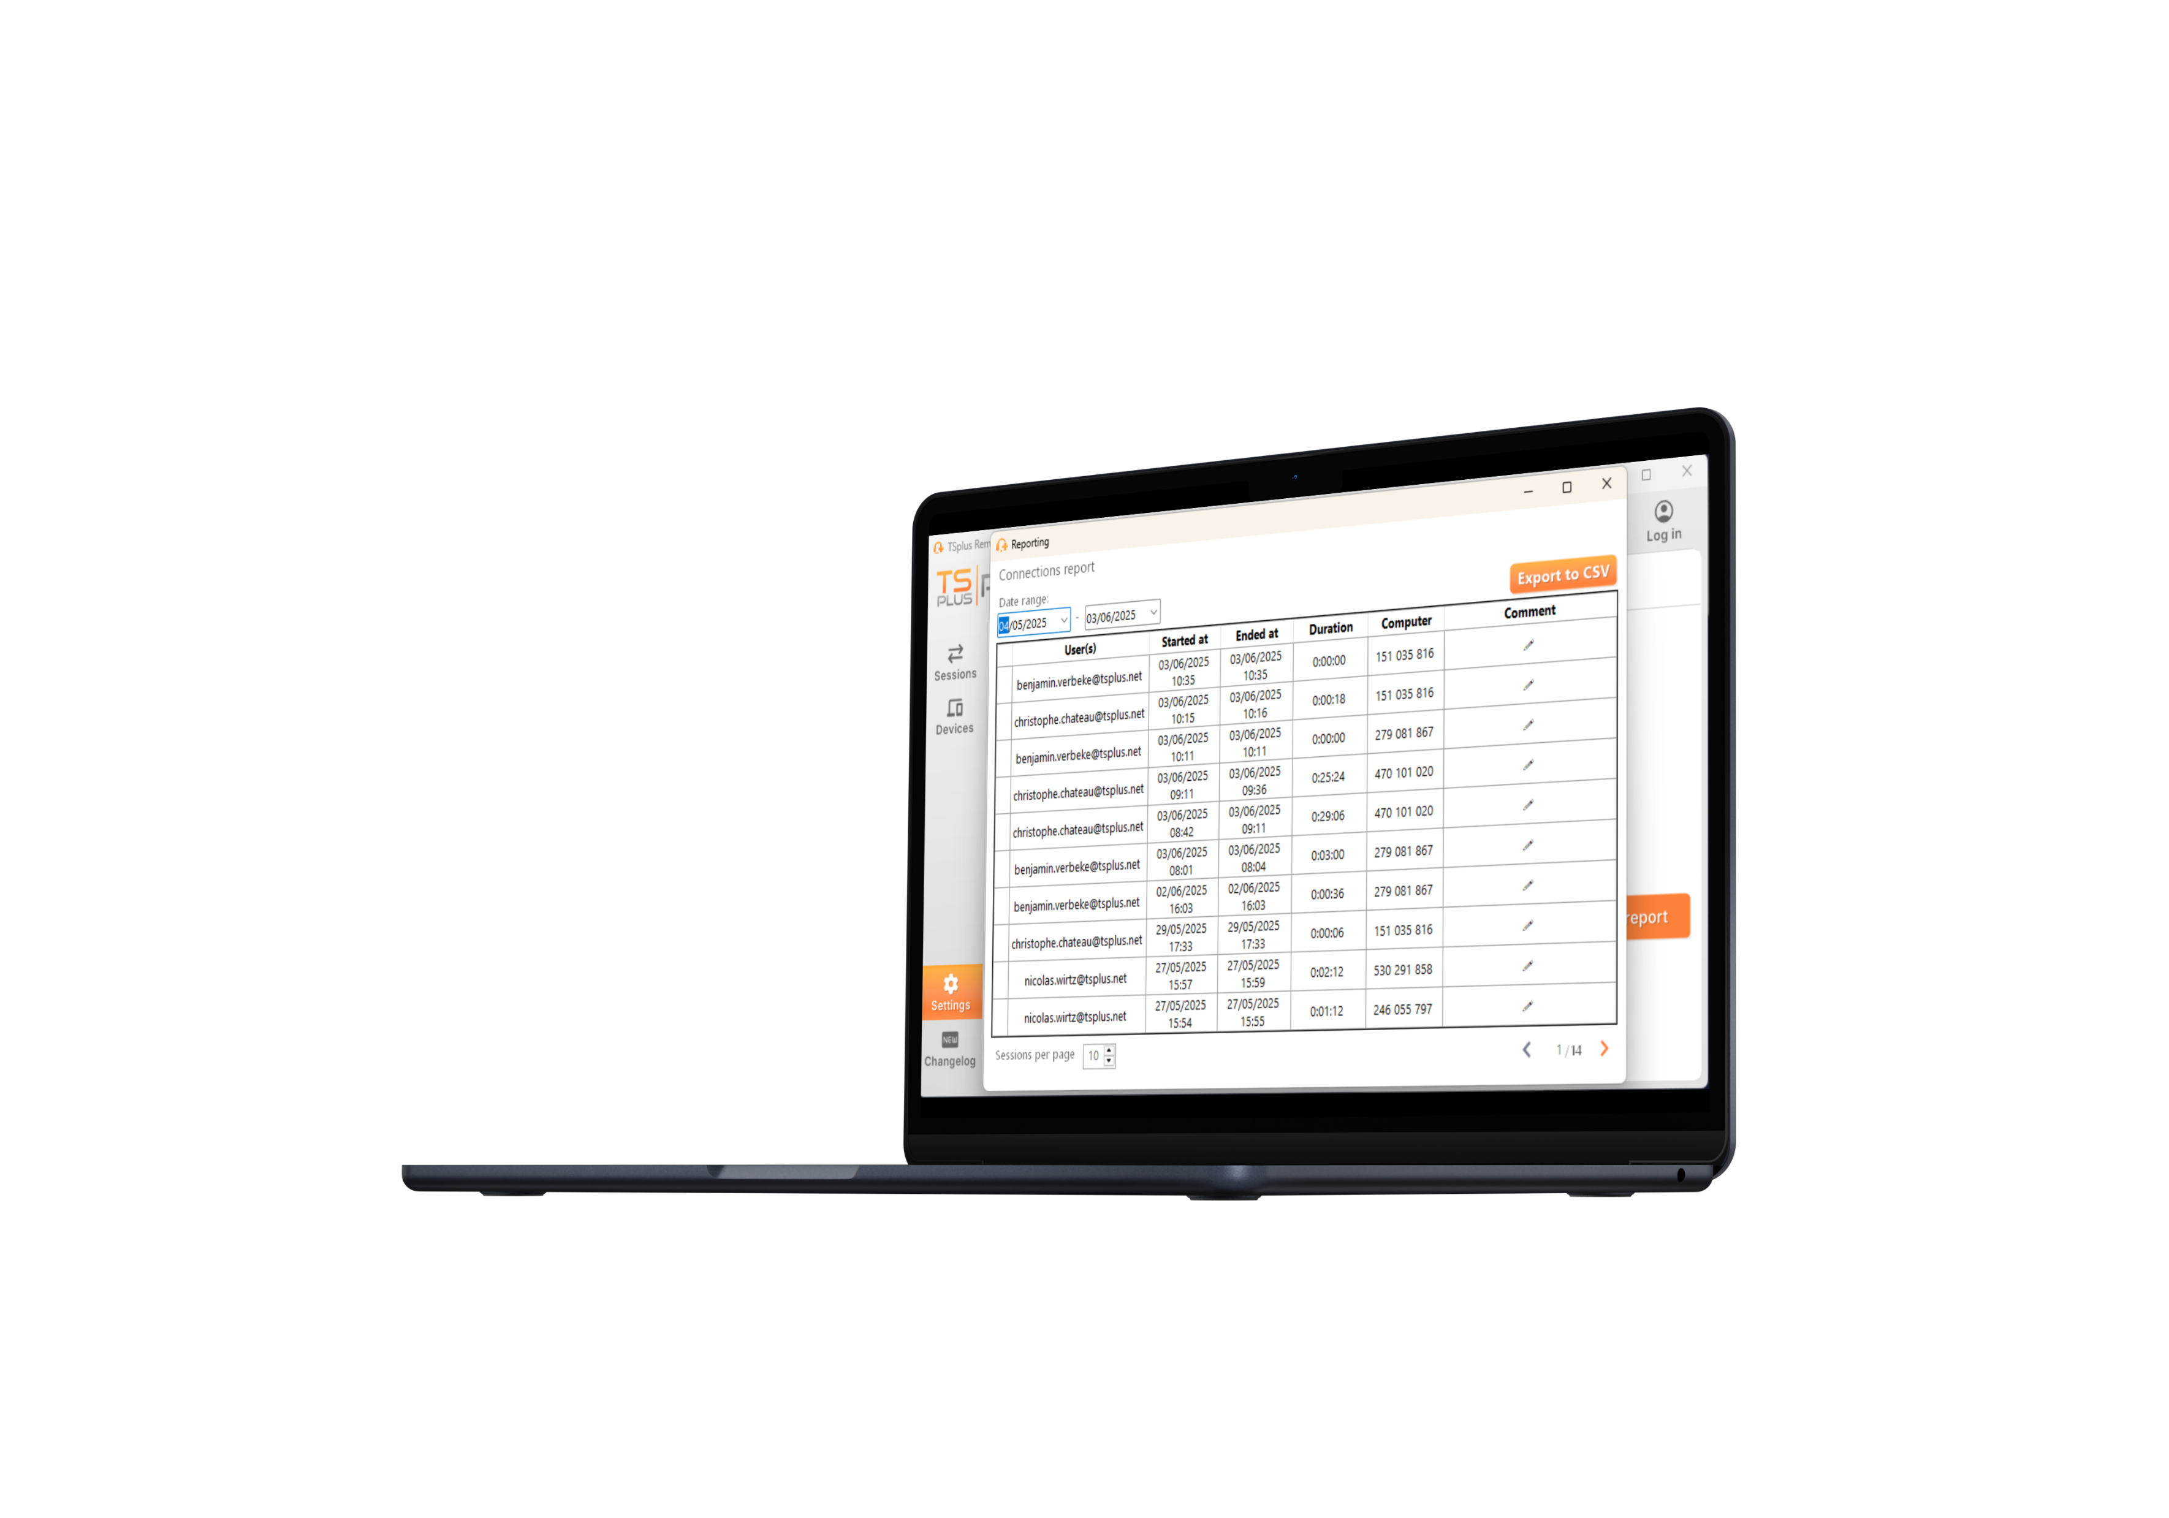
Give Your Support
Agents the Best Tools
for the Best Service
EASY COLLABORATION
6
Shareable folders
Session log reporting
Multi-agents support
Screen snapshots and recording
13

Slide 7
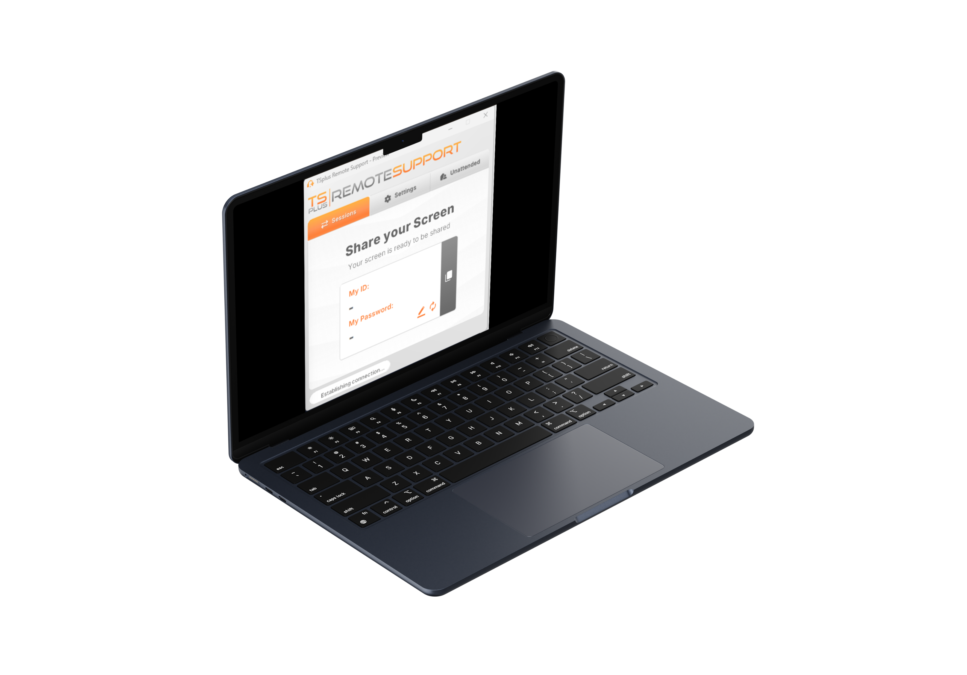
Help Your Customers
Without Struggle. Connect in a Click and Take Control!
SIMPLE CONNECTION
7
Simplified end-user interface
Universal sharing system: ID and password
One click to connect
Unattended Access and Wake-on-LAN
13

Slide 8
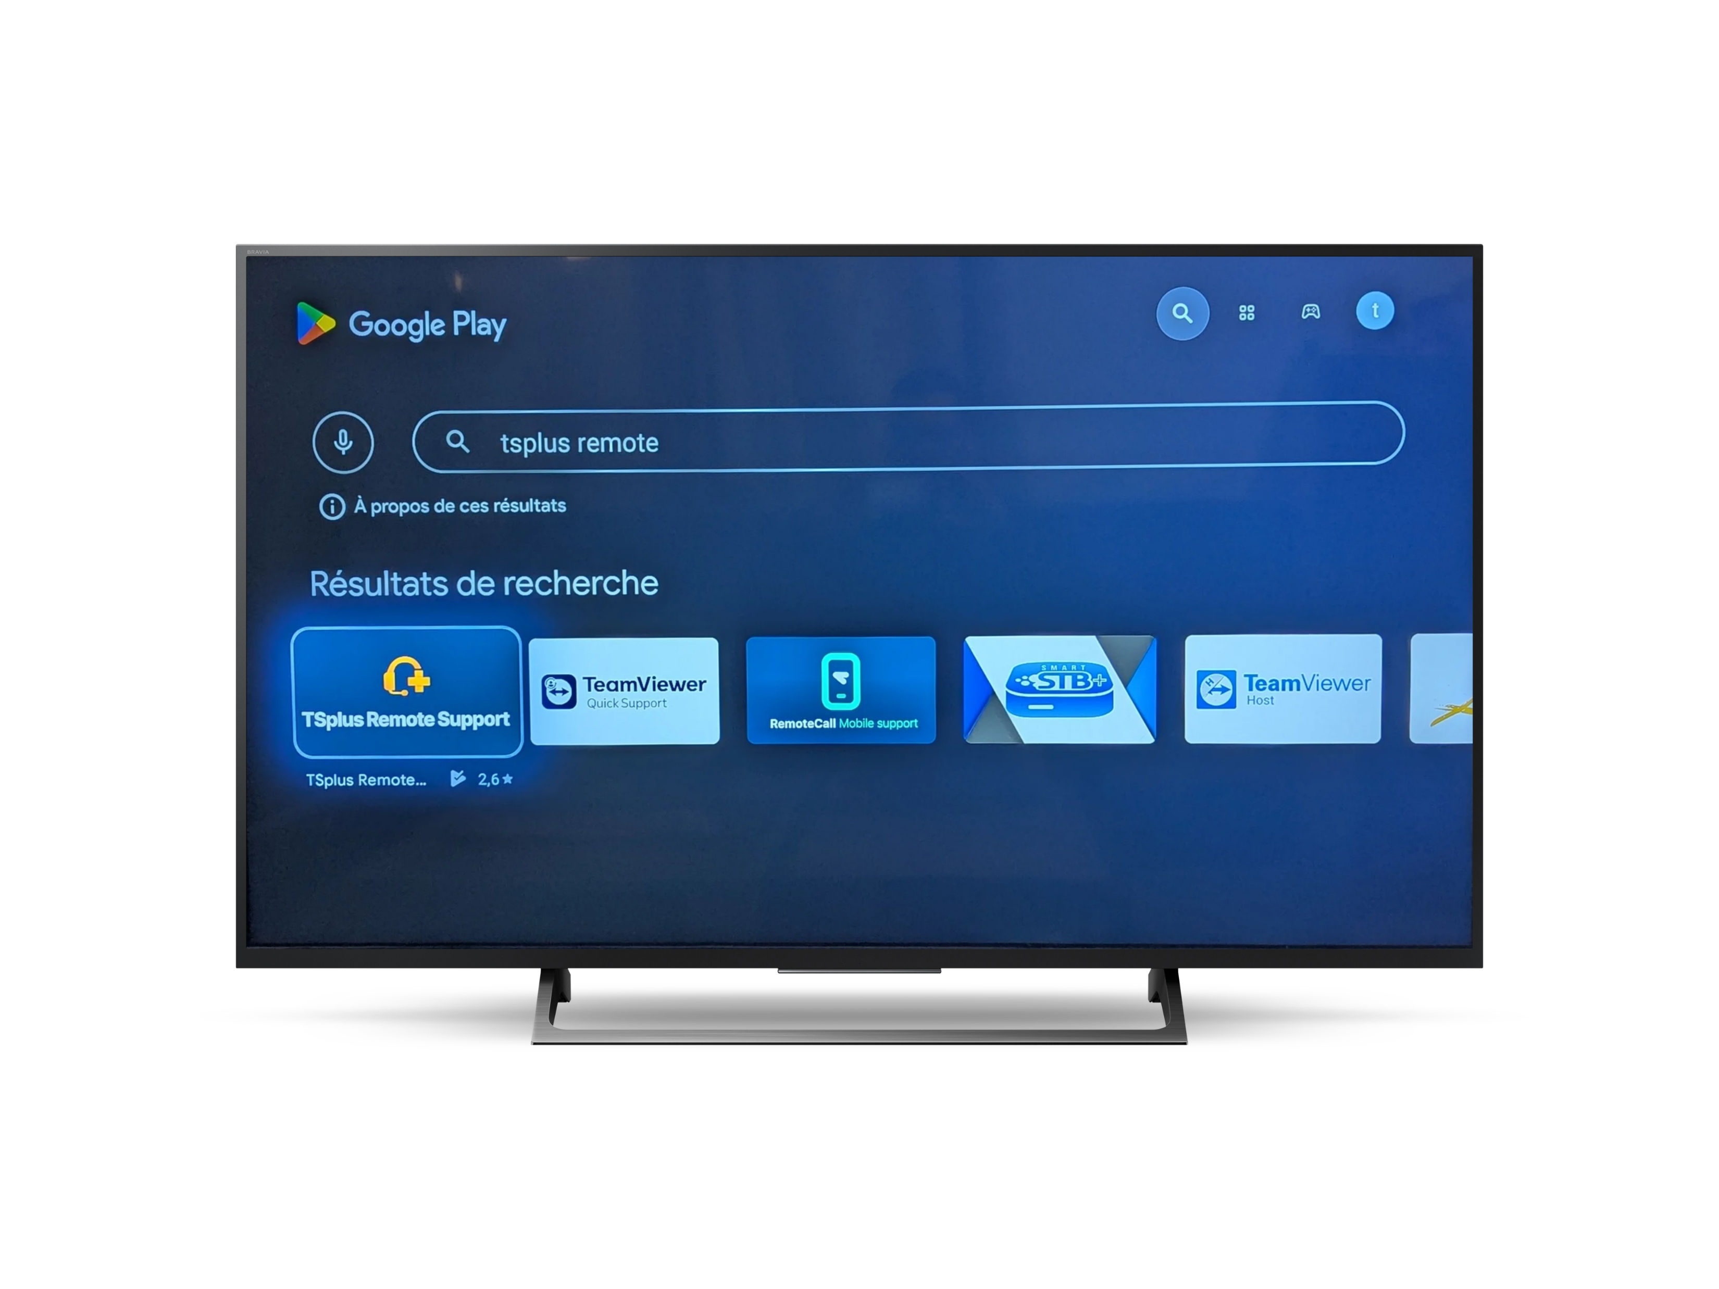
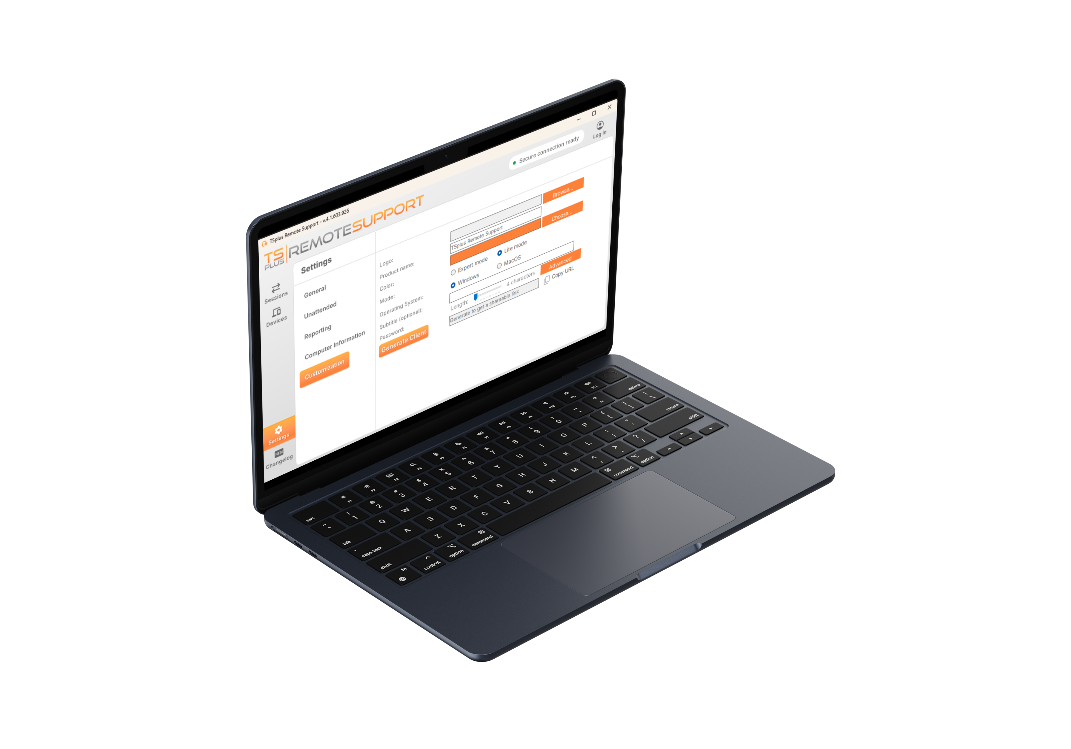
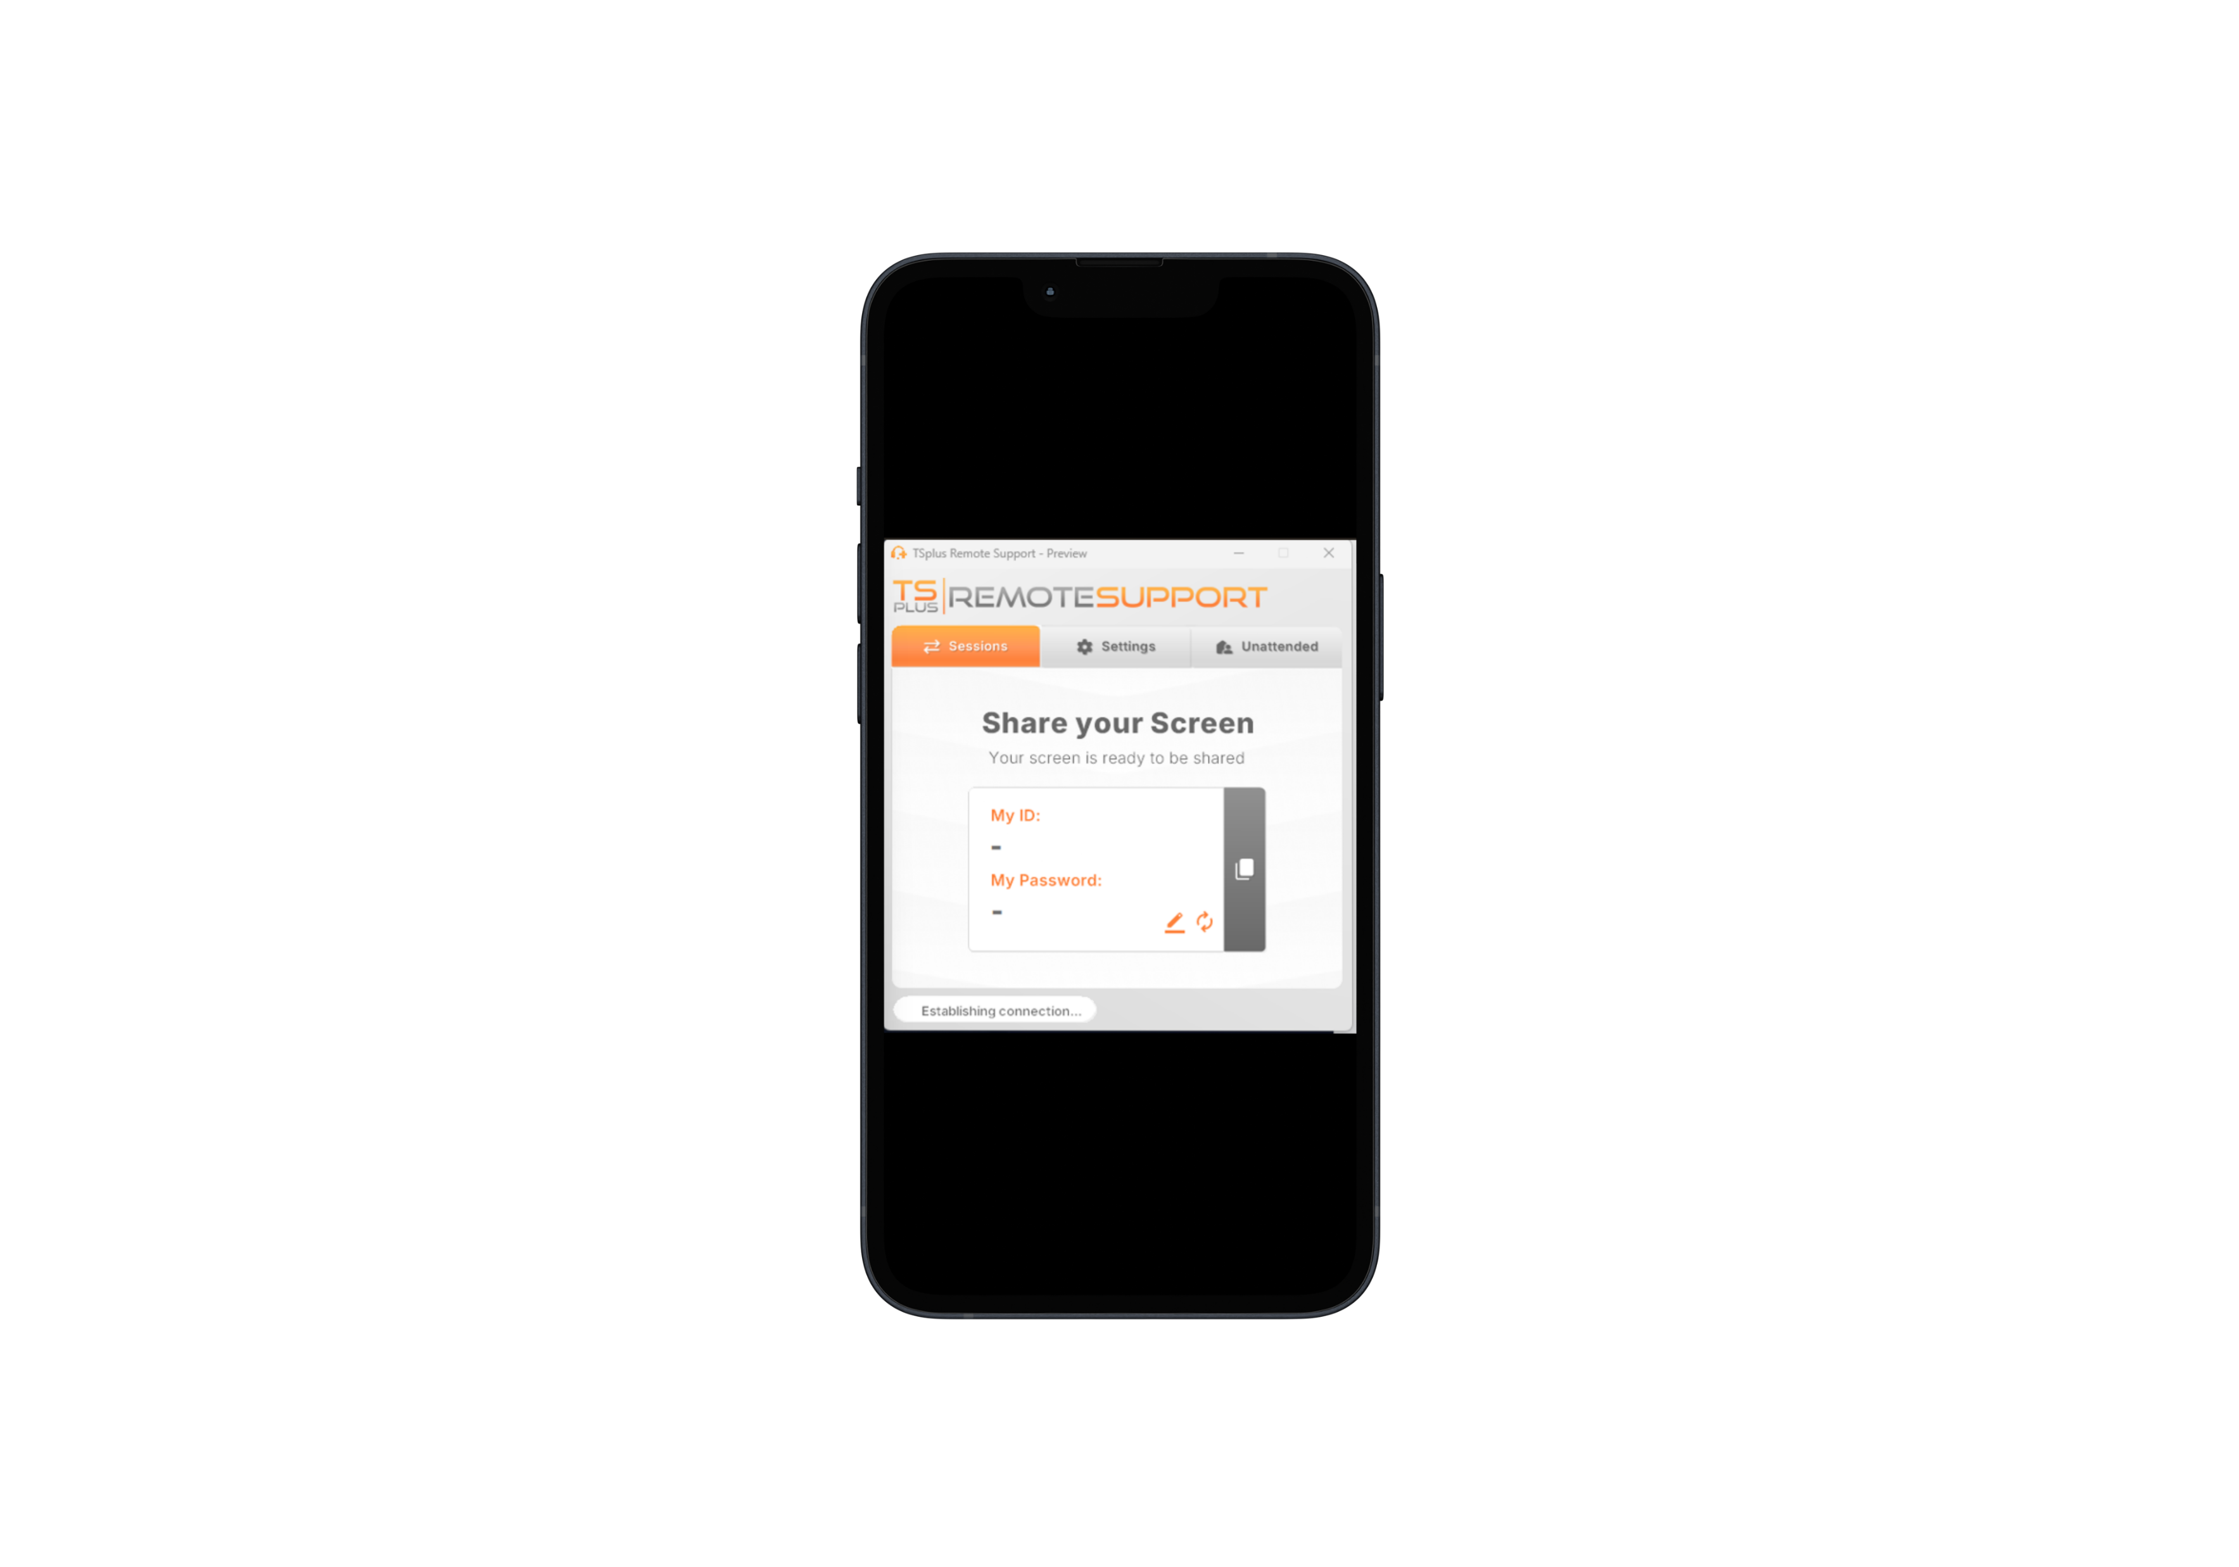
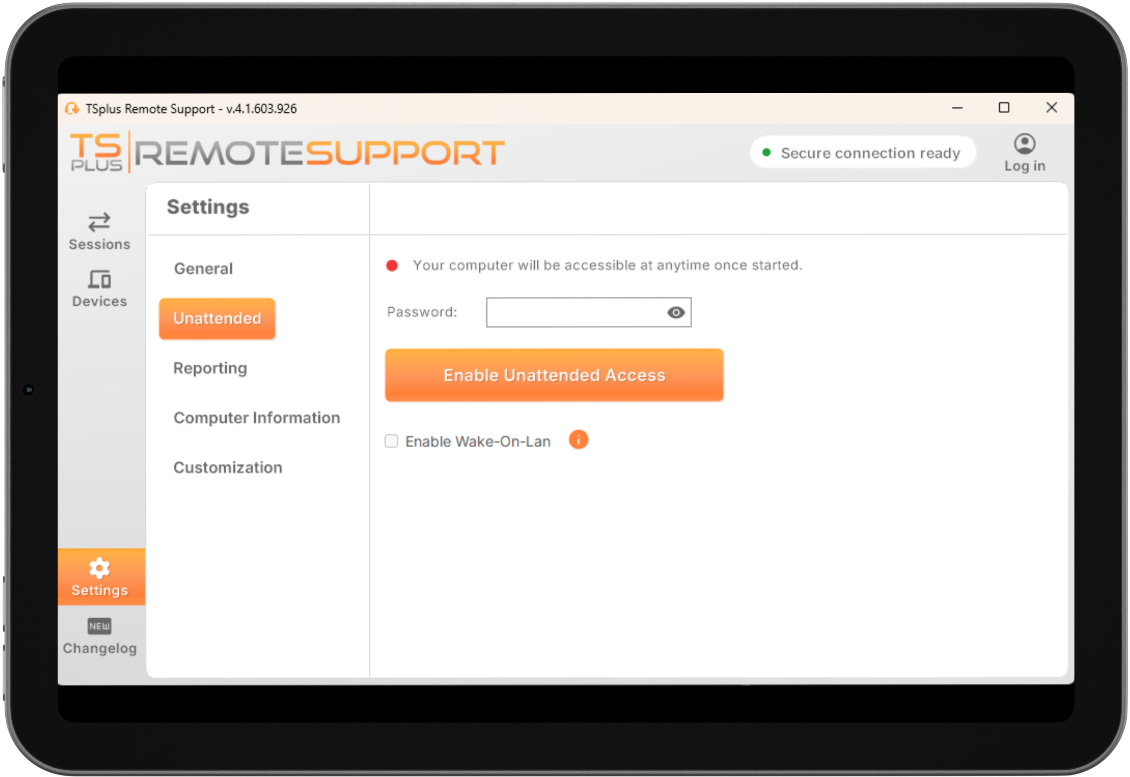
Help Your Customers
Without Struggle. Connect in a Click and Take Control!
CUSTOM SOLUTION
8
Use your own domain name and colors
White label client logon
One-time client password
Cross-platform solution
13

Slide 9
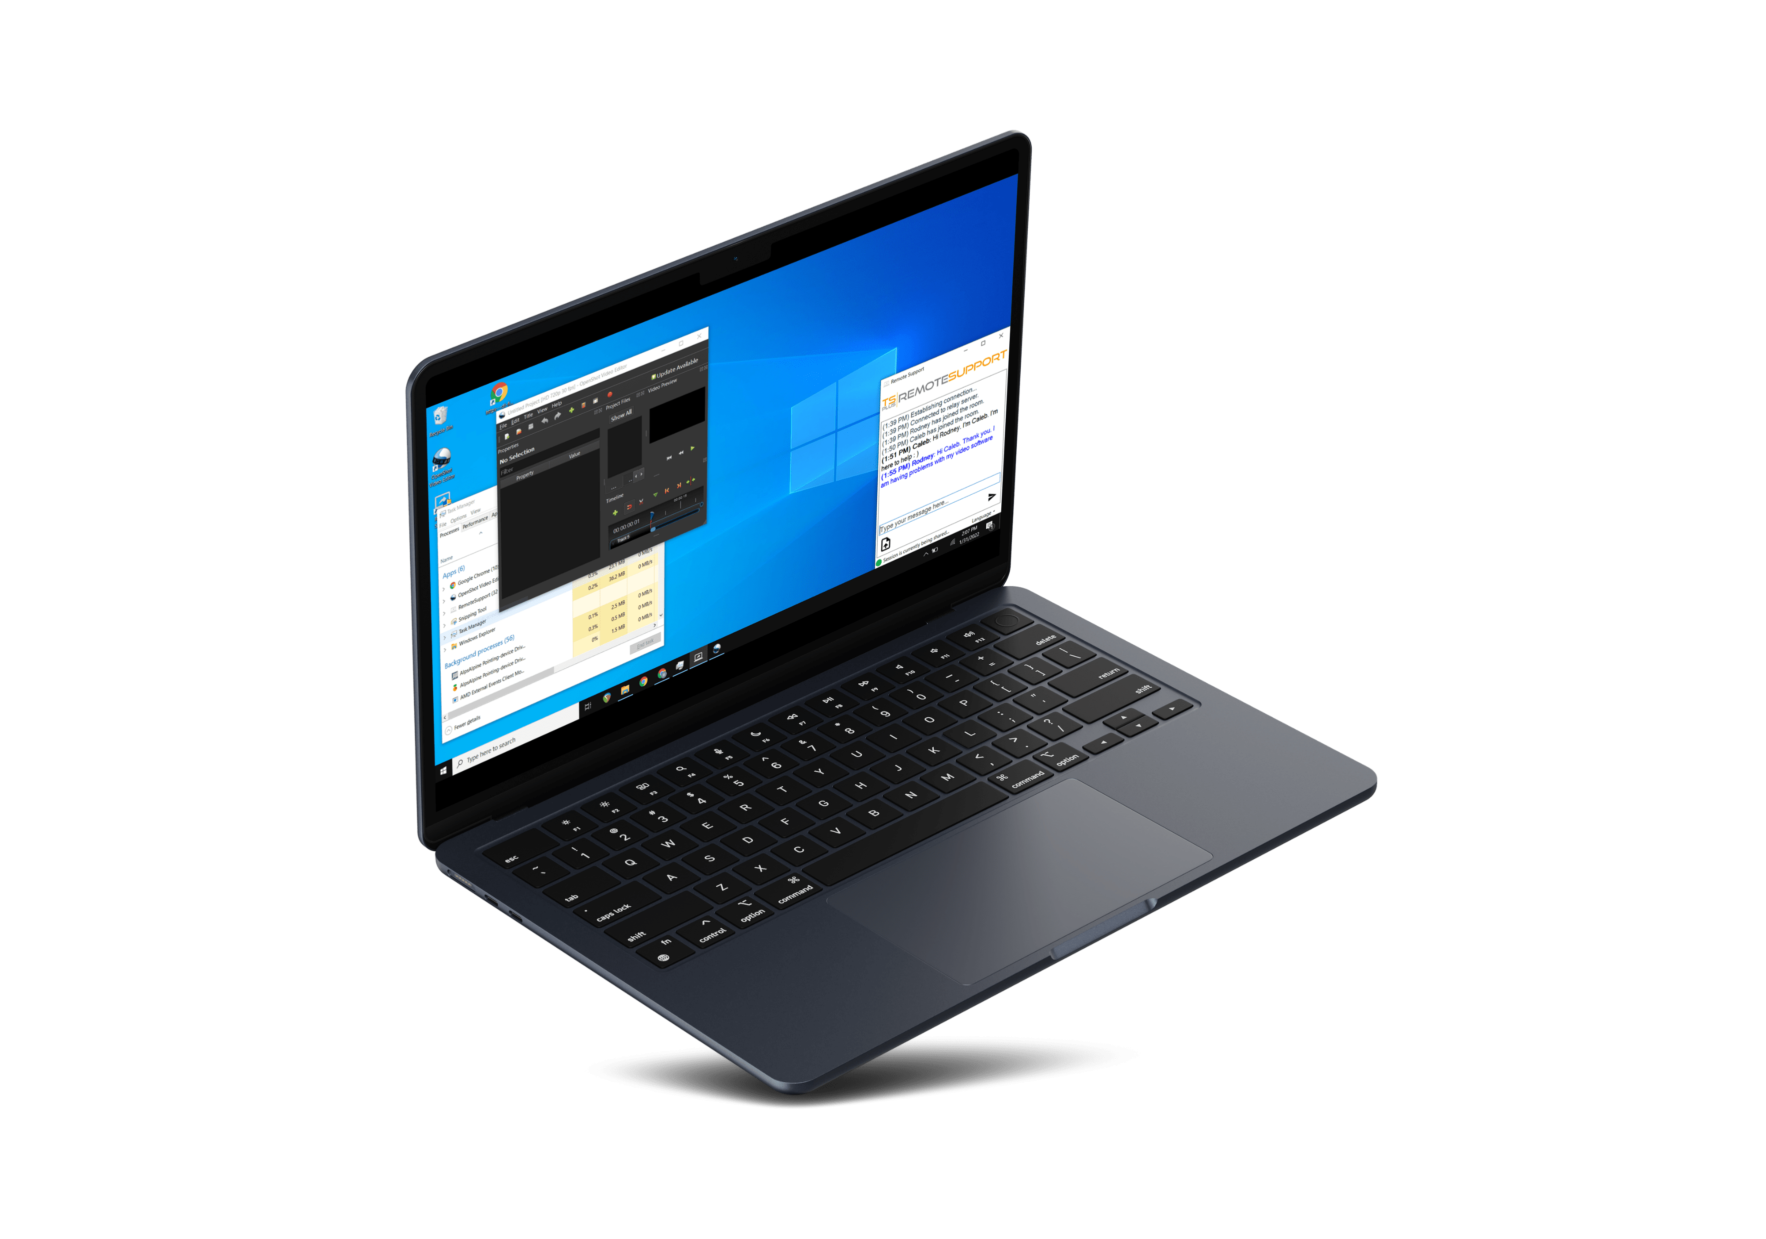
Help Your Customers
Without Struggle. Connect in a Click and Take Control!
INTERACTIVE SUPPORT
9
Communicate via chat box
Copy/paste & clipboard sync
Upload and drag & drop files
Automatic AI language-translation
13

Slide 10


Build The Trust: Ensure Session Sharing Stays Safe for Everyone
10
Secure connection relay servers.
Managed by our team of experts.
13
Security policies and permissions
Full back-end management
Regular updates and maintenance
End to end TLS encryption

Slide 11


CONNECTION RELAY
The TSplus Difference: relay servers all around the globe.
Connection via
Client logon
11
13
And Remote Support scales display quality to accommodate bandwidth limitations.
Automatic DIRECT CONNECTION
control your co-worker or client pcs from anywhere
Share your user screen, mouse and keyboard in a click

Slide 12

Why Pay More Upfront? Get a Powerful Solution That Grows with You – Subscribe!
12
Our very attractive yearly subscription starts at:
Saas
solution
PER CONNECTION PRICING
FREE TRIAL DOWNLOAD
13
$8
for 1 connection
Yearly Subscription
Unlimited Clients
15 Days
Stop whenever you want
Pay per Concurrent Connection
5 Connections
Test it Today!
Visit our website
Control your IT budget
Updates and Support Included

